Slide 1
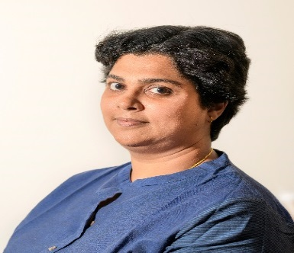
Profile
Profile brief
Nisha Menon is a Director with PwC’s Tax and regulatory practice and has over 10 years of experience both in the industry as well as in advising clients on business, tax and regulatory matters spanning across industries
Experience summary As part of her stint in the industry, Nisha led the Indirect tax function of HP India Sales Private Limited. During this stint, in addition to leading the GST implementation project for HP Inc.’s entities in India, she has also supervised compliances, provided assistance in deal support and other business related advisory, conducted trainings, set up process and controls as well as front ended litigation, from an Indirect tax perspective Additionally, she has a rich experience in advising companies on issues related to Customs, Central Excise, Service tax, VAT, Foreign Trade Policy and so forth. She has worked on various Indirect tax related structuring assignments, due diligence reviews, litigation matters as well as on Corporate tax compliances
Education qualification Chartered Accountant (ICAI) Bachelor of Commerce
Nisha Menon Director, Tax & Regulatory Services
Contact details
Cochin
Mo no: +91 9742284940
E-mail: nisha.menon@pwc.com

